Slide 1

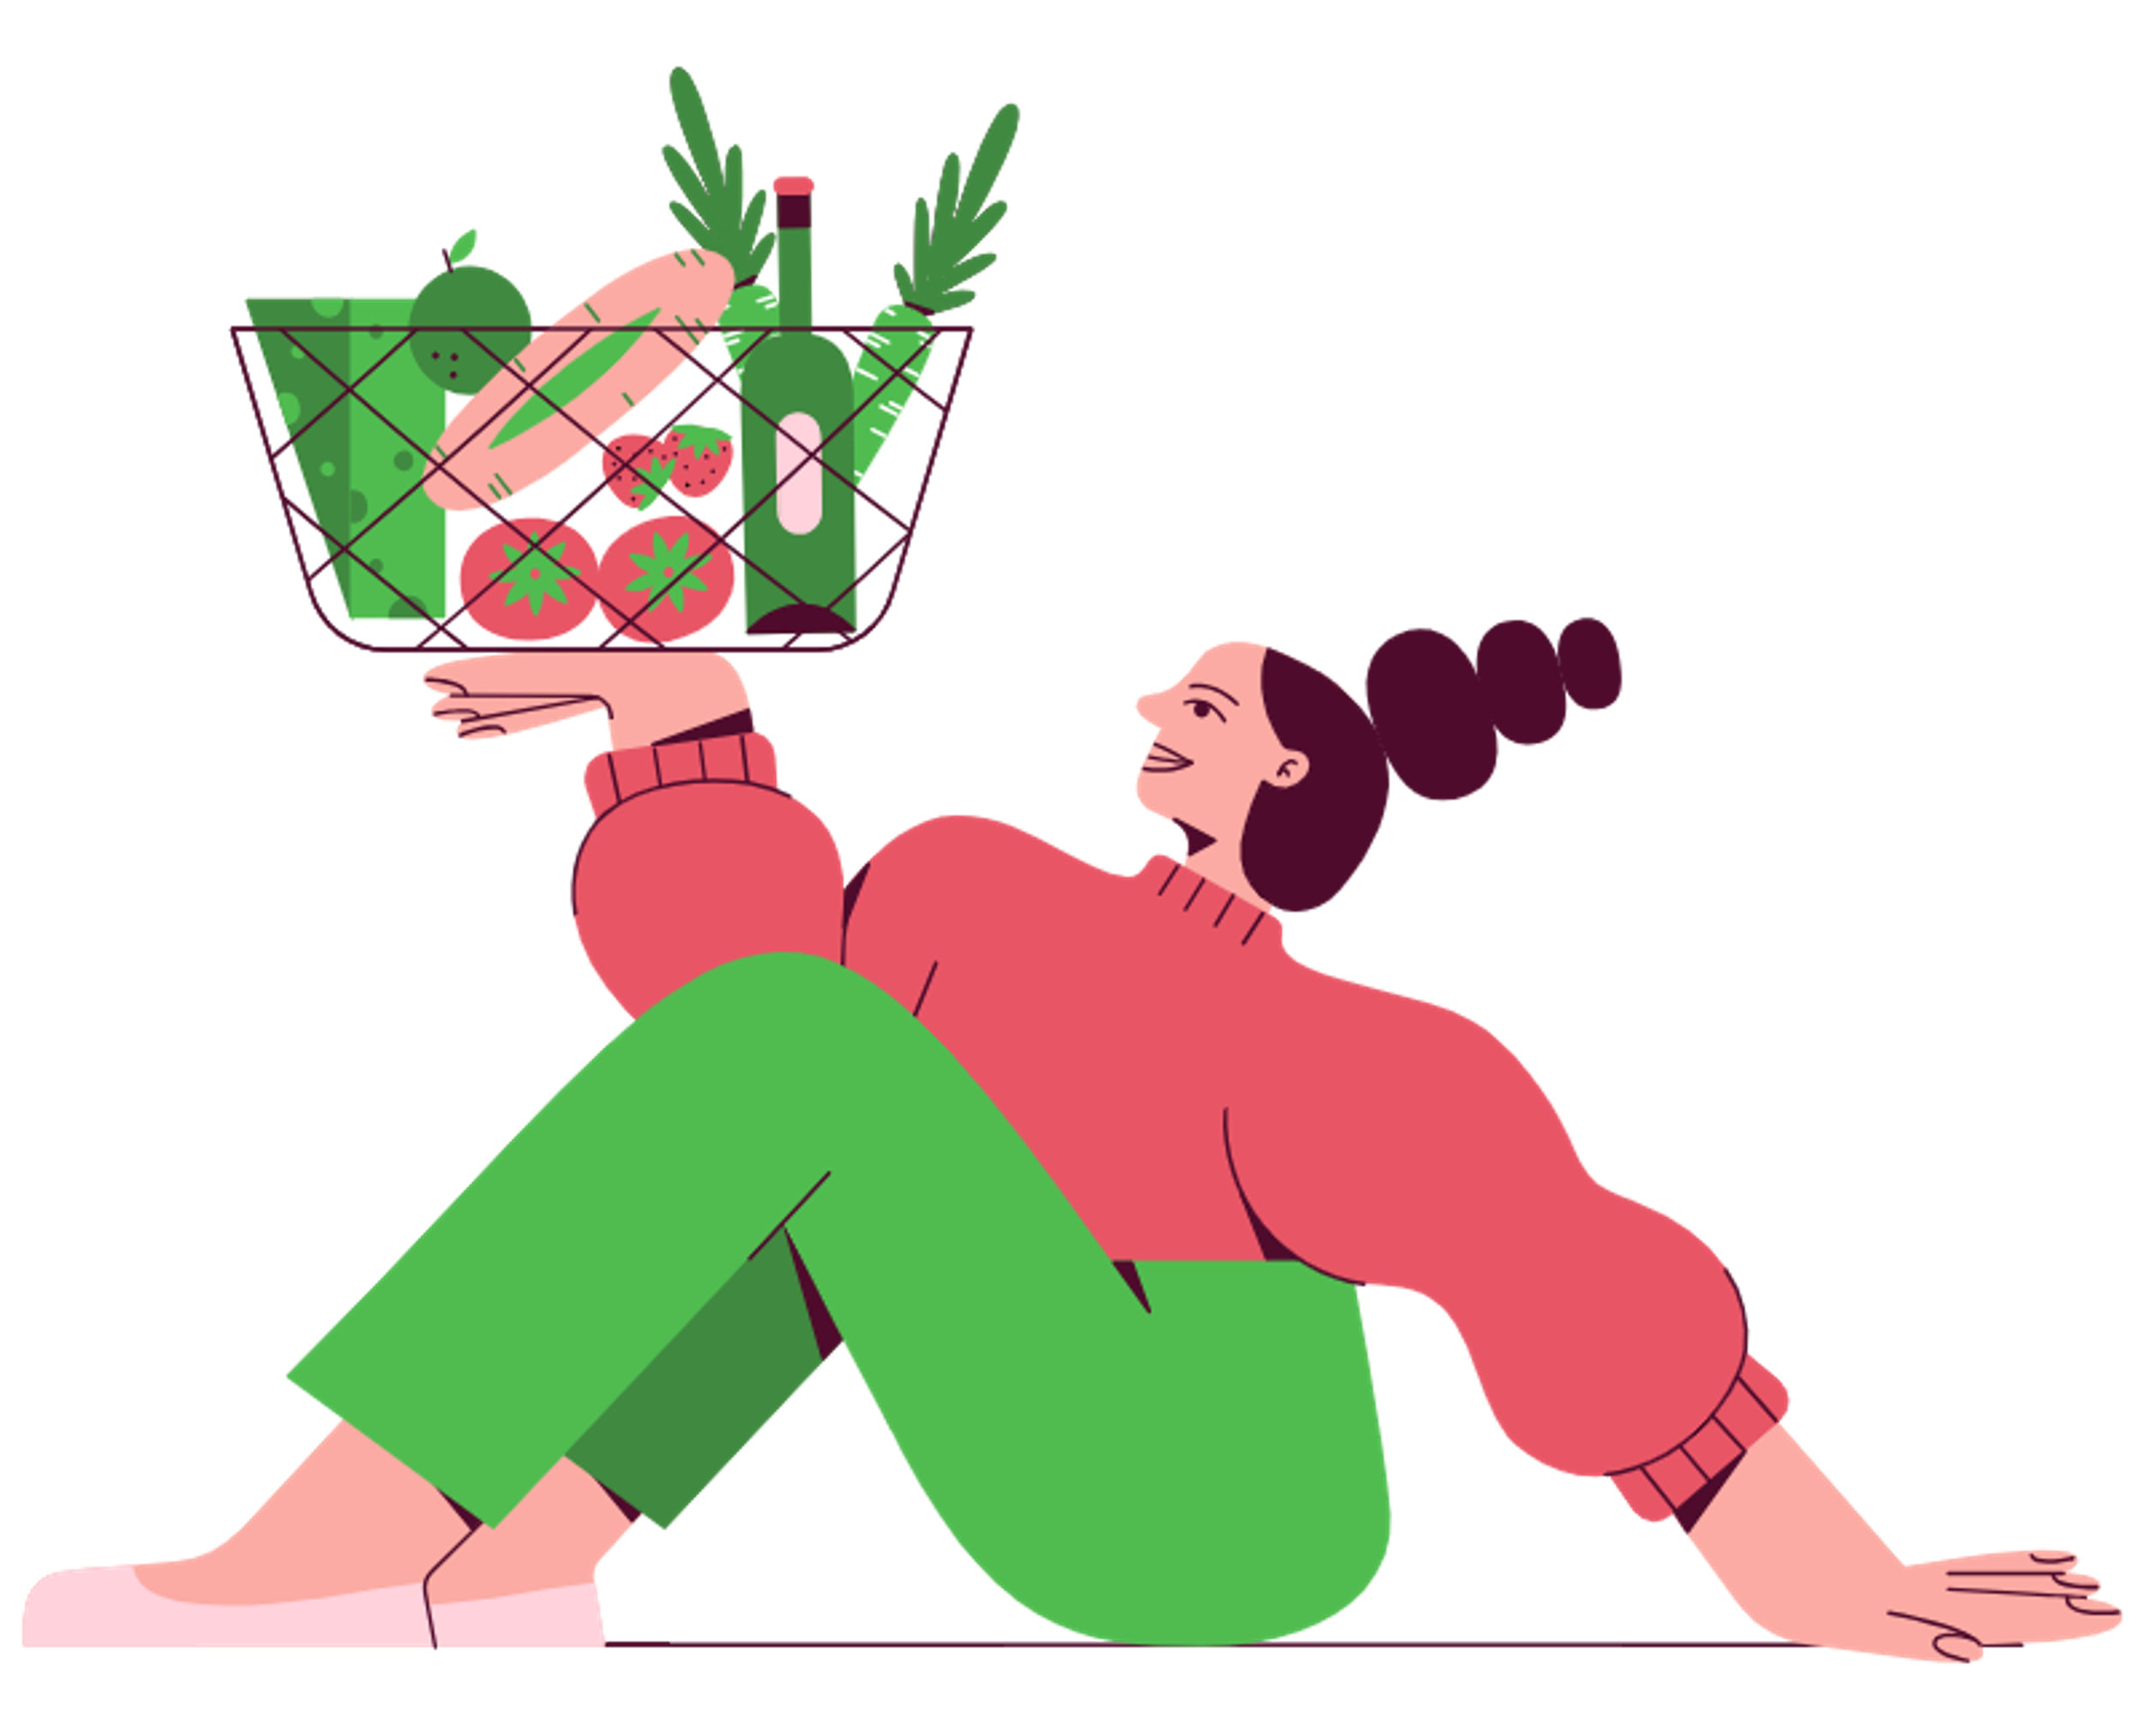






Smarter Shopping
for a
Greener World
by Idunno &
Q-Hackathon 2025

Slide 2
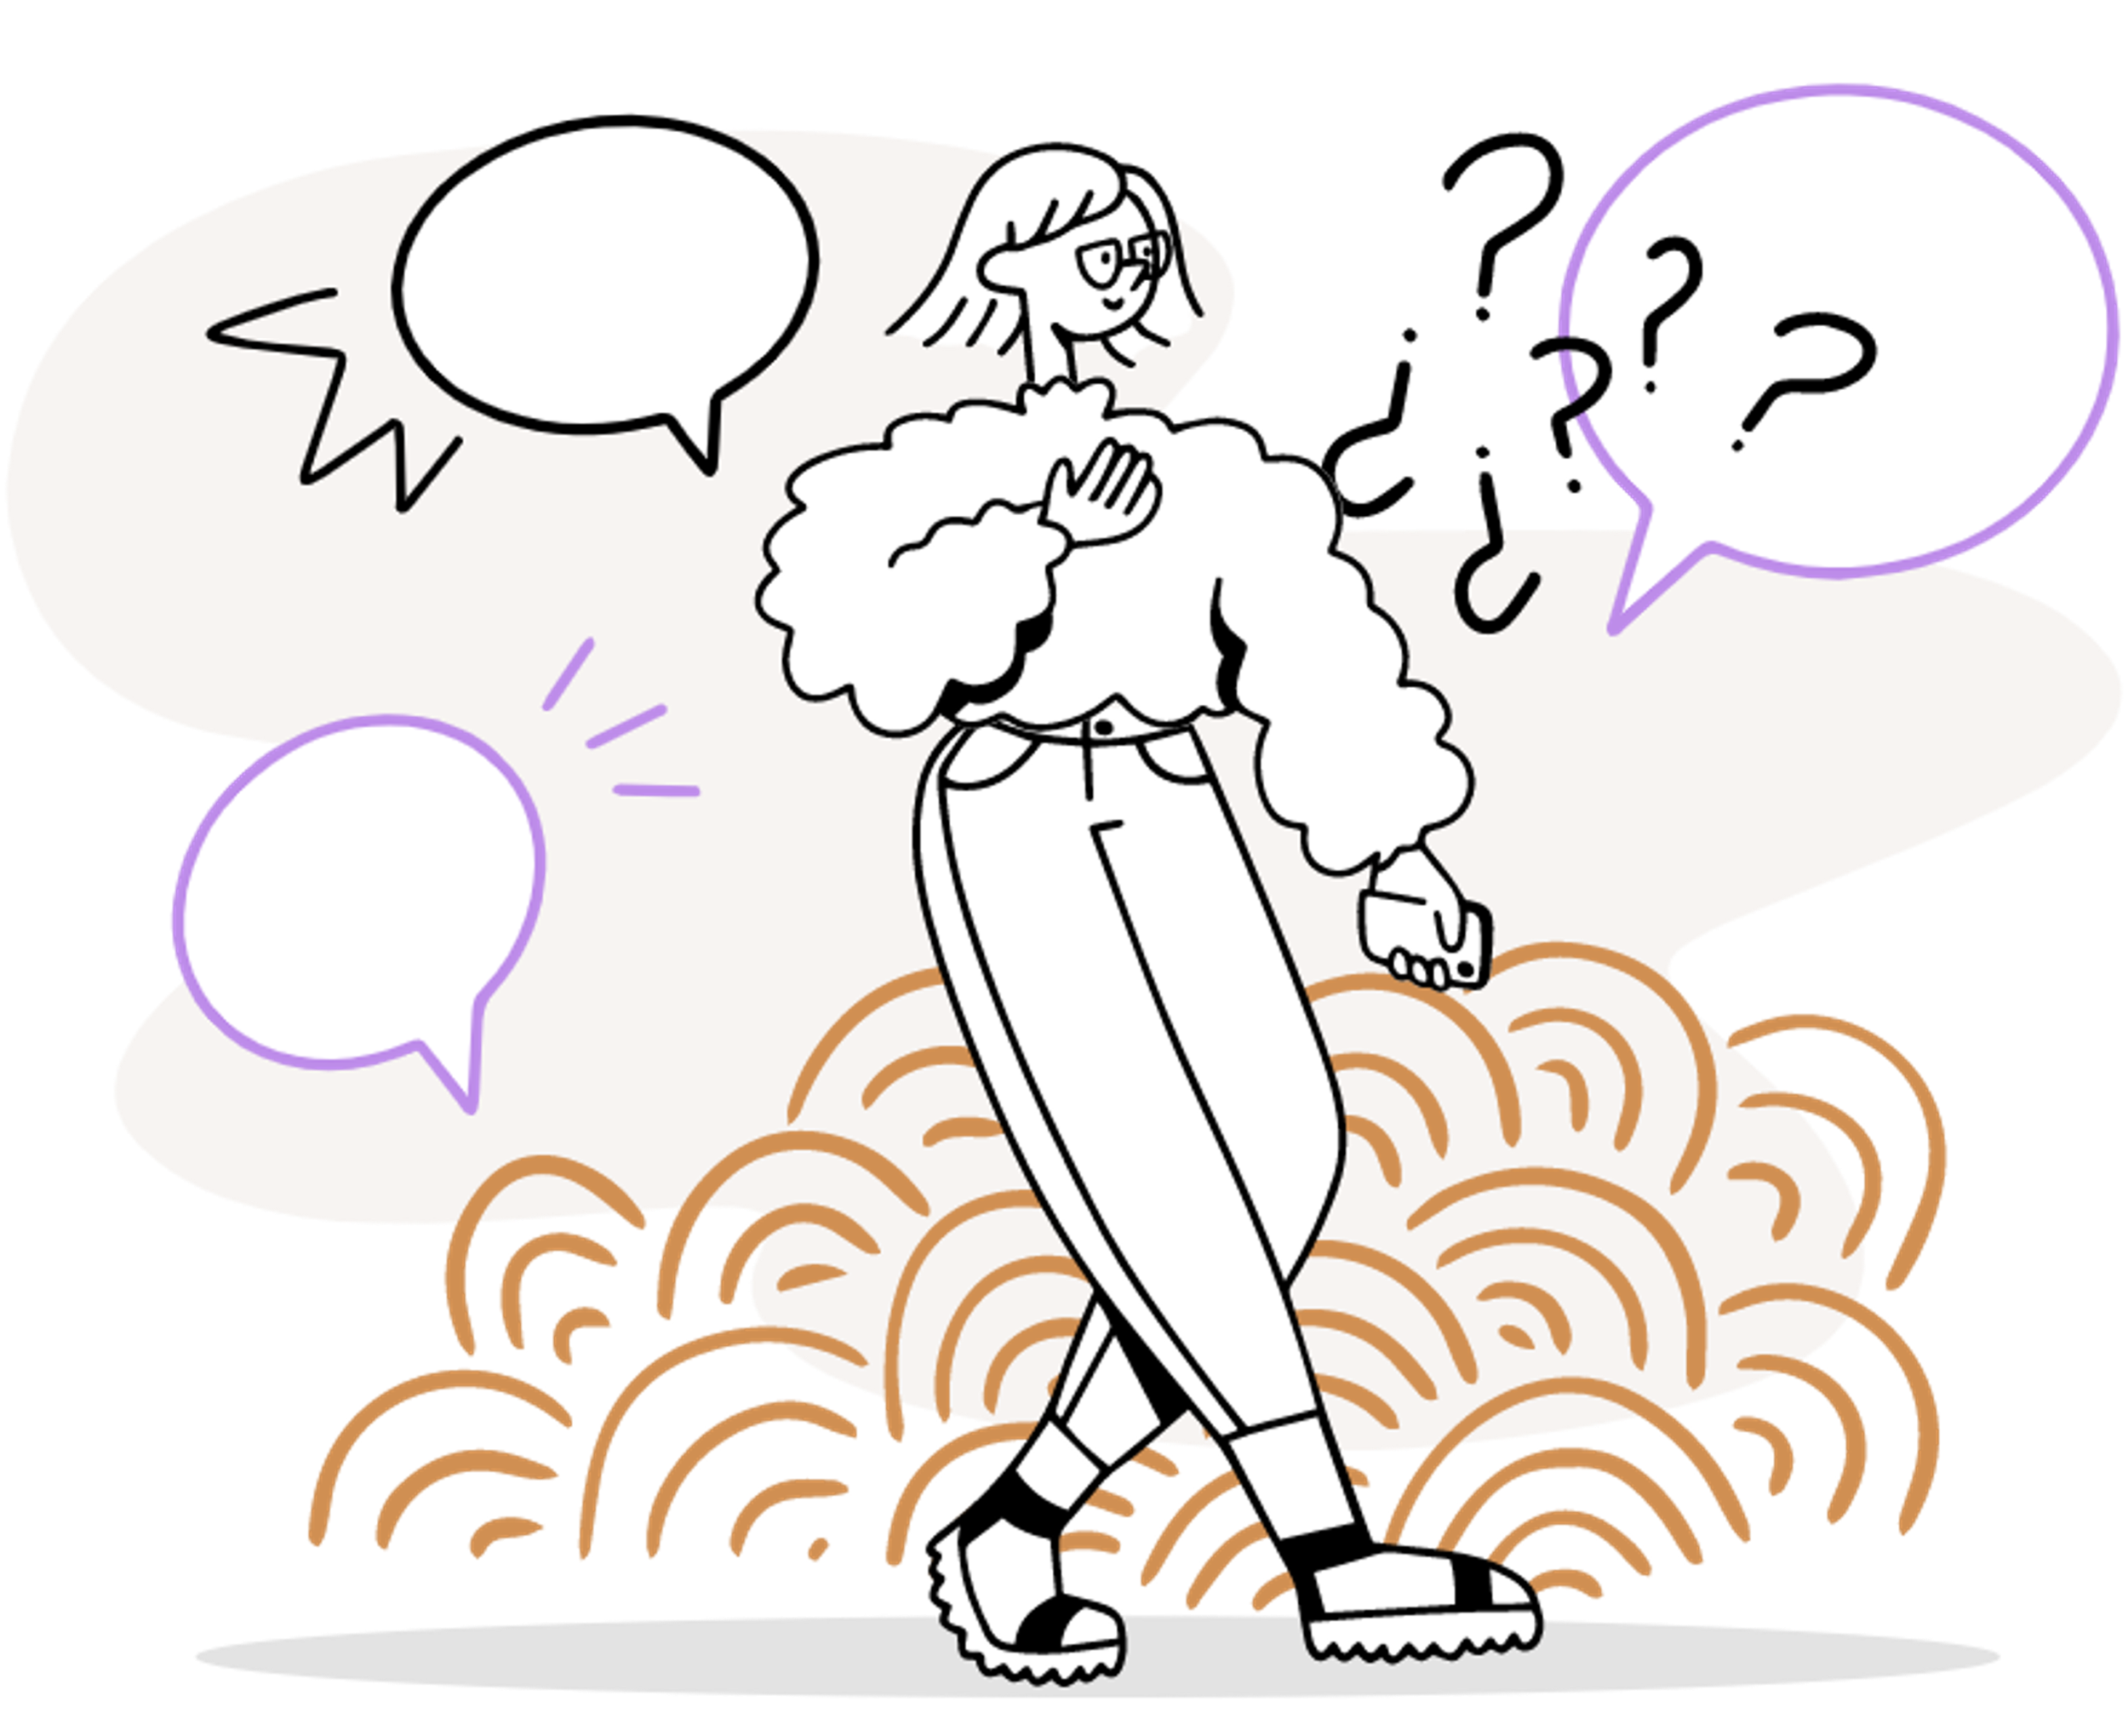





Slide 3
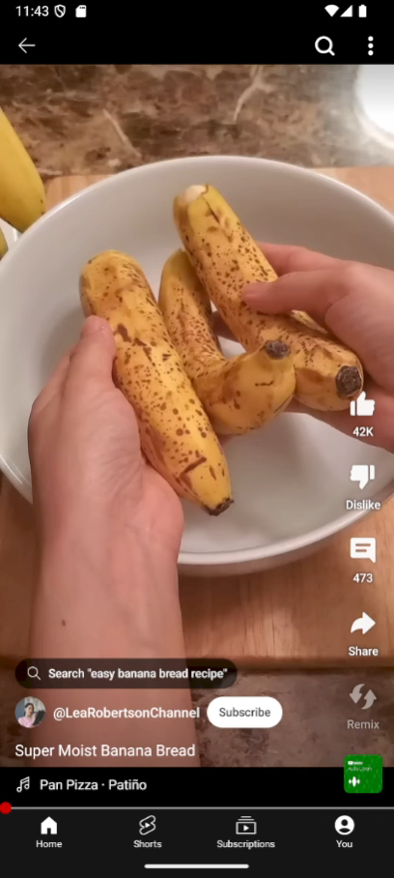


Slide 4
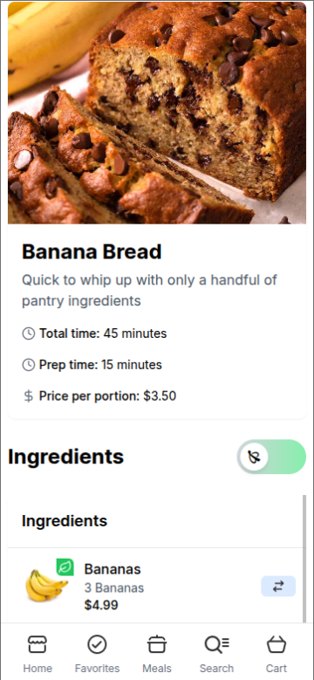
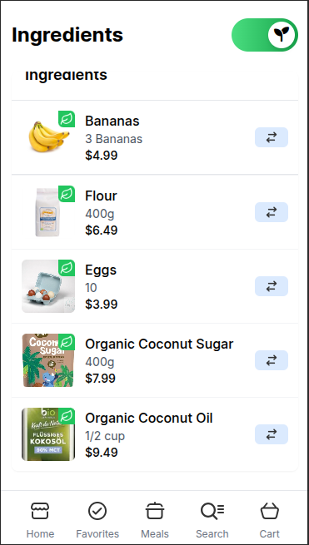
📖 Your Own
Recipe Colletion
Upload your favorite videos and get your shopping list ready!
💡Smart Filters
Filter your shopping list with tags like CO2 impact, local, organic

Slide 5



ta-da! easy
you are
a hero*
👑
* hero how? why?

Slide 6









0.2 Kg Co₂
saved together with

Slide 7
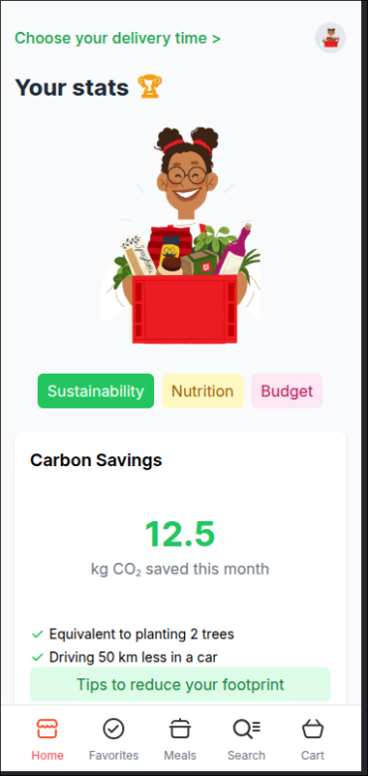
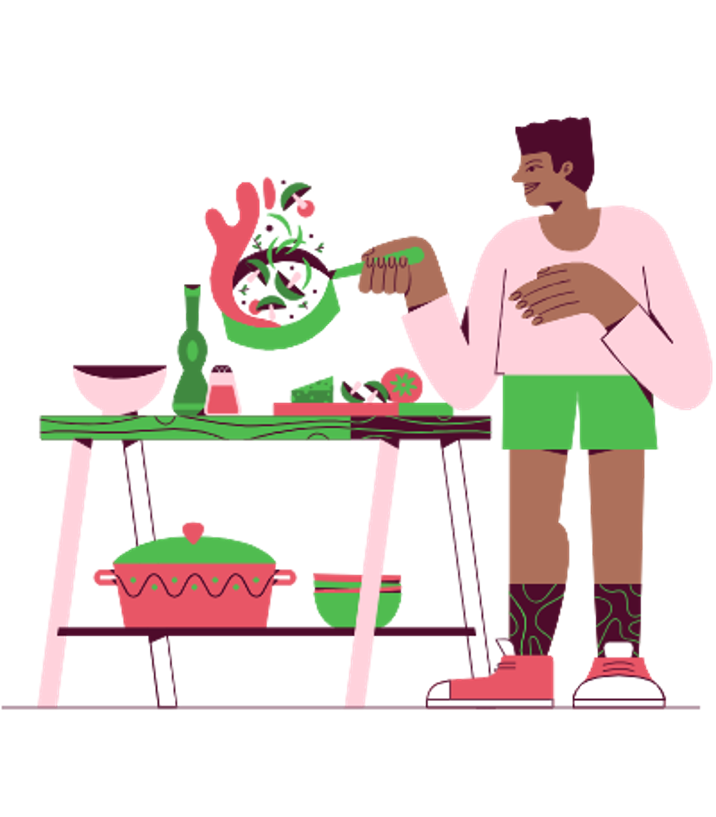
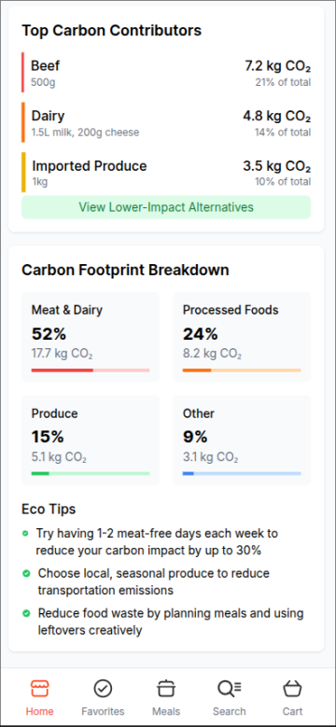


Sustainable choices
Nutrition
Smart saving

Slide 8





And there is more
to add!
More Platforms
Gamification
Ai Assistant
Add TikTok, Instagram, Pinterest & direct recipe upload from handwriting!
earn "Green Points" for eco-choices
personalised nutritional and sustainable tips

Slide 9



Let’s make the world’s greenest supermaket together!

